Slide 1
The Zen of Cybersecurity
Cybersecurity Day 1

Slide 2

Notes:
Name
Where you’re from
What you do
Why you’re here
Something about you

Slide 3

Who are the TA’s?
And what they do…

Slide 4
Bootcamp Objectives
Teach you to approach problems differently
Get you comfortable being uncomfortable
Teach you new technologies
Approach things from a cyber perspective
Give you a list of tools to add to your “toolbelt”
Find your passion and feed it
Have a blast!

Slide 5
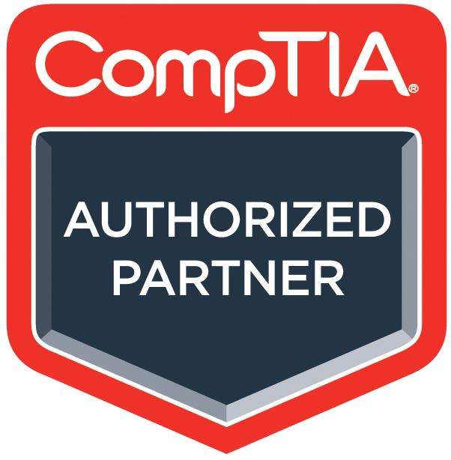
CompTIA Partnership
As part of the course, all students will receive:
Access to CompTIA CertMaster Practice for Security+
An adaptive knowledge assessment and certification training companion tool that will help you gain knowledge and prepare for the Security+ CompTIA exam
Features question-first design, real-time learning analytics, and content refreshers - this will help reinforce and test what you know and close knowledge gaps
You will receive access partway through the course
CompTIA Security+ exam voucher
Exam vouchers are good for 12 months
You will receive this at the end of course, in order to give the voucher the longest shelf-life possible and give you time to study

Slide 6
Class Objectives
By the end of class today, students will be able to:
Explain the course structure and general direction of the program.
Recognize the high-level security strategies and tools covered in class.
Explain how cybersecurity is an assessment of threats and mitigation of risks.
List different types of user, web, server, and database cybersecurity attacks.
Identify risk mitigation plan framework for user, web server, and database attacks.

Slide 7
The Rising Cyber Threat

Slide 8
Why is cybersecurity such a desired skill these days?

Slide 9




Reason 1: Explosive Growth in Dependence of IT
Nearly every personal, social, and commercial aspect of our lives makes contact with vulnerable IT infrastructure.
Notes:
Couple at table: 1187923168
Rx

Slide 10

Reason 2: More Users (Targets) on Connected Devices
More people than ever before are logged into connected devices- often for the majority of their waking (and sleeping) hours.

Slide 11
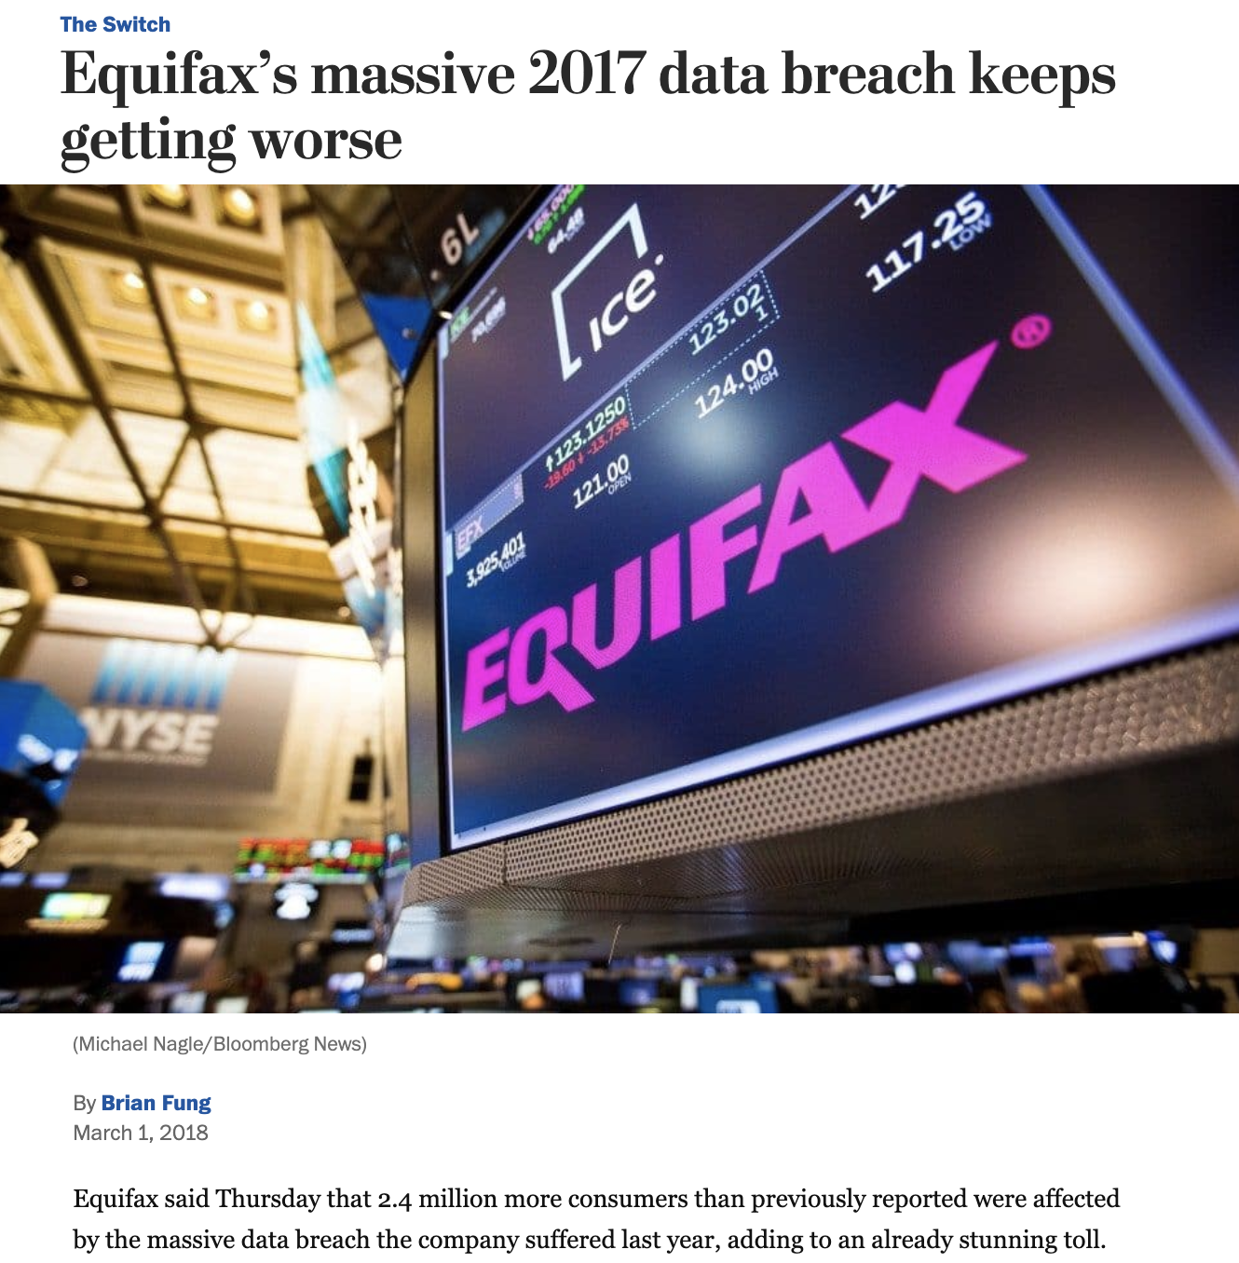
Reason 3: Better Tools for Bigger Damage
Cyber Attacks today are becoming more sophisticated, aggressive and disruptive than ever before.
Notes:
Low-Risk Image: Source https://www.washingtonpost.com/news/the-switch/wp/2018/03/01/equifax-keeps-finding-millions-more-people-who-were-affected-by-its-massive-data-breach/?noredirect=on&utm_term=.f63014925b4a

Slide 12
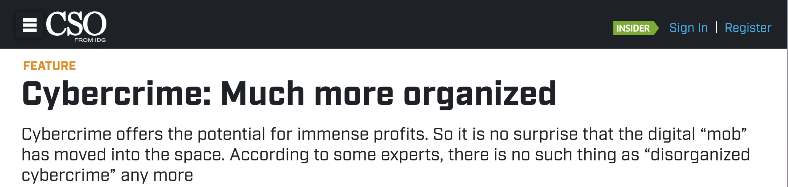
Reason 4: Significant Investment by Bad Actor
Where once the field was populated by individual “lone hackers”, today it has become a focal point for organized crime, nation states, and private enterprises.
Notes:
Headline source: https://www.csoonline.com/article/2938529/cybercrime-much-more-organized.html

Slide 13

Reason 5: Dire Shortage of Skilled Professionals
According to studies by (ISC)², there will be over 1.5 million unfilled cybersecurity positions by 2020.
“70% of cyber security professionals say that their organization has been impacted by the ongoing global cybersecurity skills shortage.”
Notes:
Quote Source: ESG Research Report, The Life and Times of Cybersecurity Professionals, November 2017

Slide 14
Defining Cybersecurity

Slide 15
What is the first thing you think of when you hear “cybersecurity”?

Slide 16
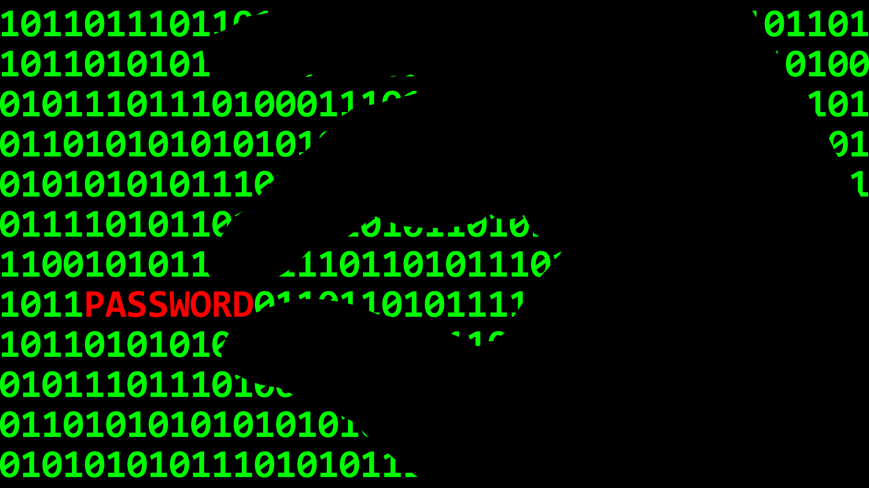

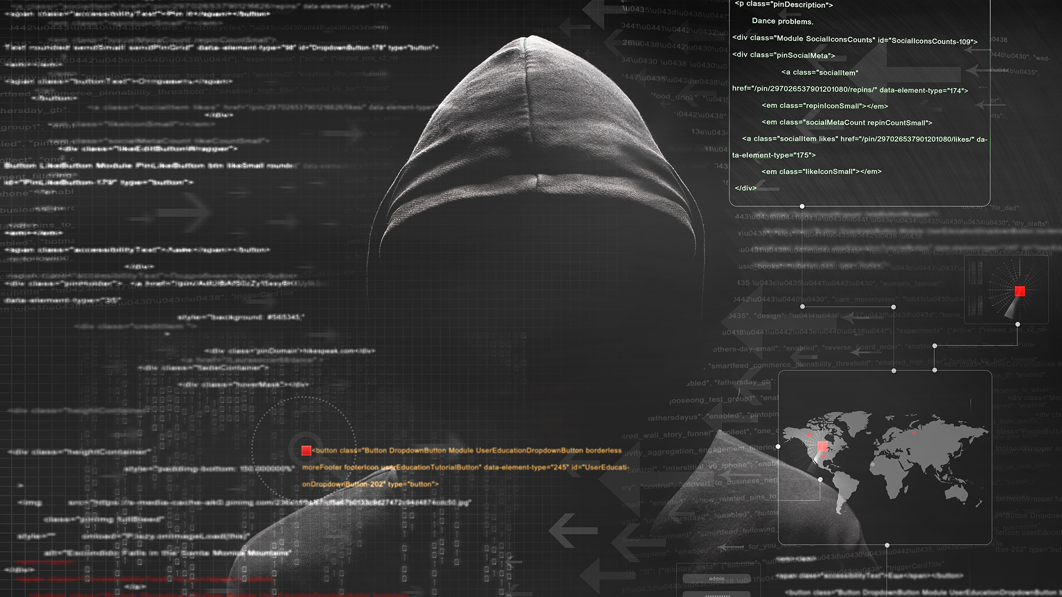

Everyone’s First Thoughts:
Hackers and Complicated Code...

Slide 17
Everyone’s First Thoughts:
But cybersecurity isn’t about complicated code and hackers...

Slide 18

Cybersecurity is really about assessing threats and mitigating risks.

Slide 19

Assessing Threats:
Let’s say we found a USB drive laying on the ground…
How much of a threat could it really be?
Let’s find out!

Slide 20
Your Turn! The Case of the Crazy USB
5 Minutes
Quick Activity:
Turn to the person next to you and discuss what could happened.
How might it be that a USB drive was able to immediately execute running code?
Why didn’t our computer stop the drive from running?
How might we defend against malevolent USBs like this?

Slide 21
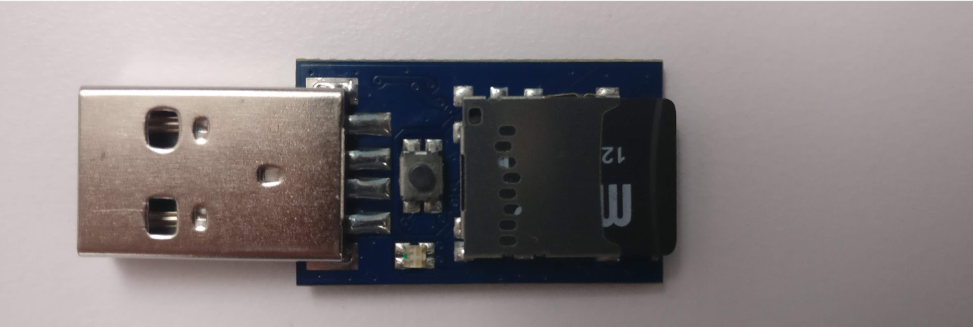
A Harmless USB?
The USB is actually a mini keyboard-emulator. When connected, our computer registers it as a keyboard allowing it to kick off without restriction.
Like most threats, their appearances are deceptively safe-seeming.

Slide 22
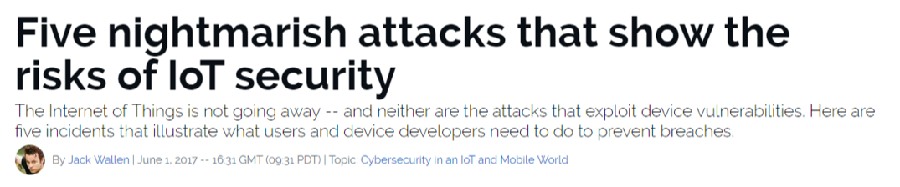
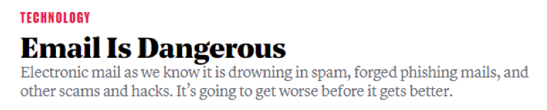
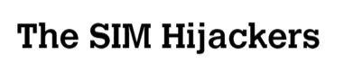
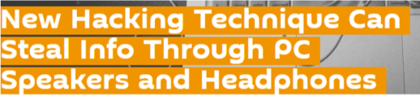

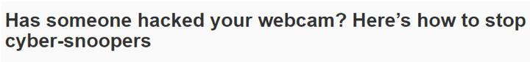
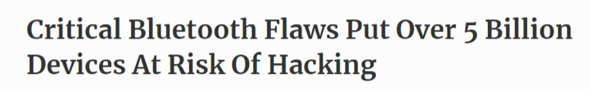
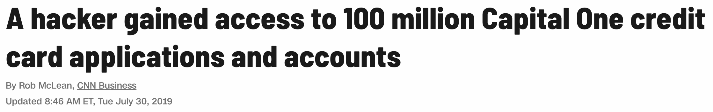
Know Thy Threats
To the experienced cybersecurity professional, risks are everywhere.

Slide 23


Mitigating Risks
Historically, organizations viewed cybersecurity from the lens of the castle model. Walls were built and managing risks meant keeping the bad guys out.
Today, security professionals operate in a world where breach is assumed, and the risks associated with such events also need to be mitigated.
Notes:
Castle: shutterstock_699336349
Trojan horse: shutterstock_33882460

Slide 24
Course Overview

Slide 25
Our Future Tool Belt
Our Goals
Threat Assessment
Risk Mitigation
Our Tools
Network Security
Web Security
OS Security
Cryptography
Penetration Testing
Vulnerability Assessment
Security Policy
Risk Analysis
Compliance Strategy
Operational Security
UNIX Command Line
Wireshark
Kali Linux
Nmap
Nessus
Metasploit
Burp Suite
SIEMS and more...

Slide 26
Daily Routine
In class, we’ll run through the follow:
Set Objectives
Brief Background Lecture
Instructor Demonstrations
Thought Exercises
In-Class Skill Builders
Project Work

Slide 27
Curriculum at a Glance
 | Week 1
 | Week 2
 | Week 3
 | Week 4
 | Week 5
 | Week 6
 | Week 7
 | Week 8
 | Week 9
 | Week 10
 | Week 11
 | Week 12
 | Week 13
 | Week 14
 | Week 15
 | Week 16
 | Week 17
 | Week 18
 | Week 19
 | Week 20
 | Week 21
 | Week 22
 | Week 23
 | Week 24
Weeks 1-7 Command Line and Programing
First, we will undertake a rigorous exposure to Unix,
the command line, Python 3, Wireshark, networking,
encryption, hashing, and malware analysis.
Weeks 8-13 System Admin and Web Vulnerabilities
We will dive into Linux system administration, web
development and website attacks. We will use
Tools like Burp Suite, Snort, and Network Inspector.
Weeks 14-21 Defensive and Offensive Security
Security Information and Event Management (SIEM),
Incident Response, and Forensics are covered in depth,
Followed by three weeks of penetration testing.
Weeks 22-24 Governance, Risk, and Test Prep
We’ll conclude with risk analysis, governance, and compliance.
In the final weeks we’ll focus on test prep and a final project.

Slide 28
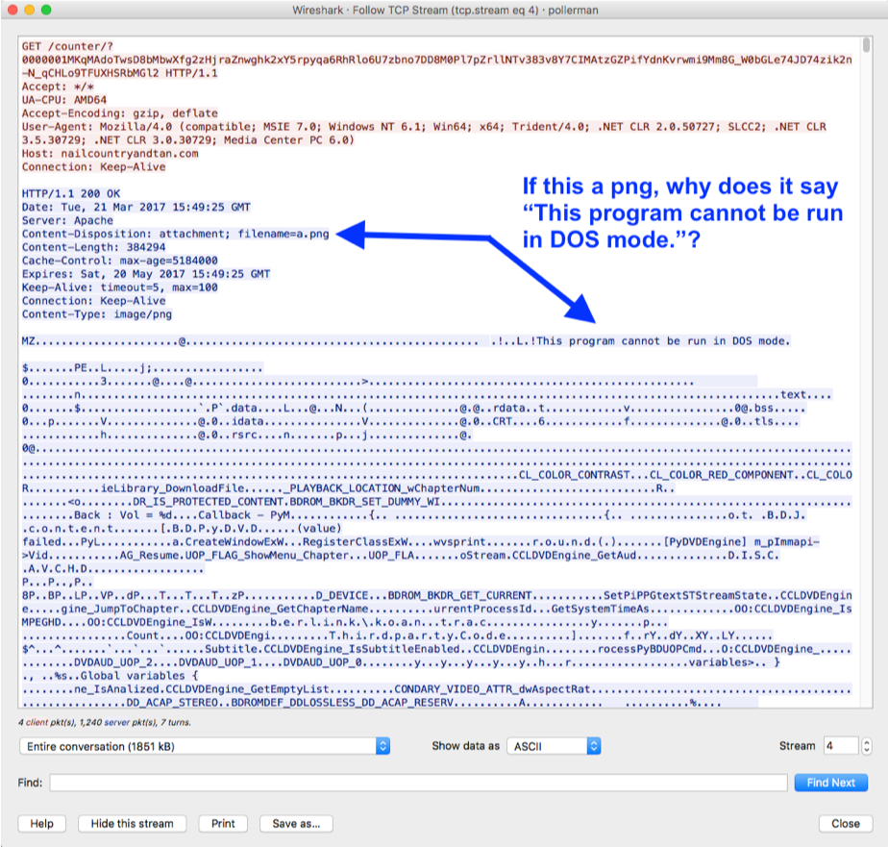
Example Activity: Analyzing Web Traffic for Malware
We’ll learn to process complex network traffic logs to find evidence of malware being sent across networks.

Slide 29

Example Activity: Encryption / Decryption Systems
Plaintext
Ciphertext
Encryption
Readable Message, File or Data
Encrypted Message, File or Data
Key(s)
Decryption
We’ll learn how modern cryptography works and how historic methods of encryption could be broken through simple means.

Slide 30




Example Activity: Web Application Hardening
1
Attacker
1. Attacker sends script-injected link to victim (e.g. email scam).
2
2. Victim clicks on link and requests legitimate website.
10101001100101010110101001111010100101010100100101010001010100010100111010100110010001100101001
4. Malicious script sends victims private data to attacker.
4
3
3. Victim’s browser loads legitimate site, but also executes malicious script.
We’ll learn how web applications can be defended against the most common attacks.

Slide 31
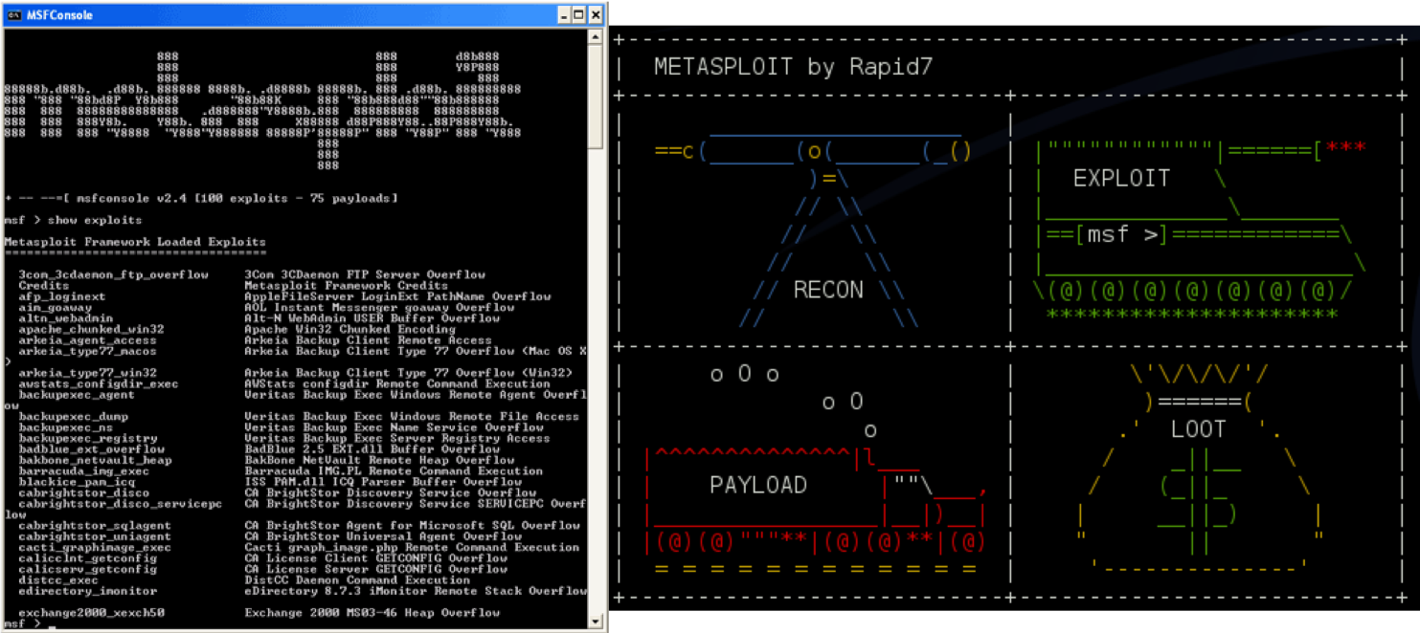
Example Activity: Identify Vulnerabilities in Unpatched Systems
We’ll learn to use tools like Kali Linux, Nmap, and Metasploit to run penetration tests to identify known exploits.

Slide 32
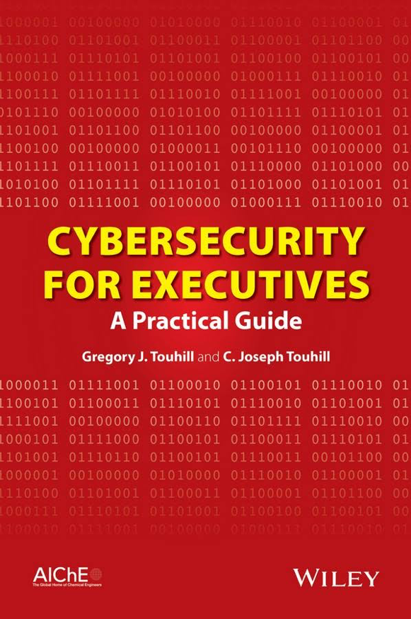
Example Activity: Cybersecurity Policy and Strategy
Lastly, we’ll learn how to talk about cybersecurity risks, strategy, and policy in a way that extends away from the laptop and into the C-Suite.
Notes:
Book published by Wiley, 2014

Slide 33

Embrace Your Inner Toddler
This should be you.

Slide 34








Tip: Embrace being a beginner.
Once you admit you “know nothing” (or little) about the many subject areas we’ll covered in this bootcamp, you’ll be able to dig into these new topics and invest the time necessary to succeed.

Slide 35
Tip: Find Your Community Now
You and your classmates are in this process together. Use each other for help!
You all can bring value to the table. Don’t be afraid to speak up!

Slide 36
Tip: You need to put in the hours!
There is no magic pill. This bootcamp will require time and effort for you to learn and succeed.
This class will challenge you… Make sure to celebrate your progress along the way.

Slide 38
Activity: Security Challenge #1:
Attacking the Wall
In this security challenge, you and your group will play the role of security professional tasked with handling a real-world situation.
Let’s go over the scenario...
15 Minutes

Slide 39

Security Challenge #1
We met on BondingThroughBitcoin.com!
Congratulations!
You and your team have just been hired by a supremely successful startup that runs a Bitcoin Dating Exchange.
Notes:
Shutterstock ID: shutterstock_433992649

Slide 40

Security Challenge #1
Secure our code?
Nah...
While their founding team is brilliant, like many start-ups,
they don’t know the first thing about security.
Notes:
Shutterstock ID: 433992649

Slide 41

Security Challenge #1
They just handed you a bucket load of cash to solve their single most pressing problem.
Notes:
Shutterstock ID: 237968428

Slide 42
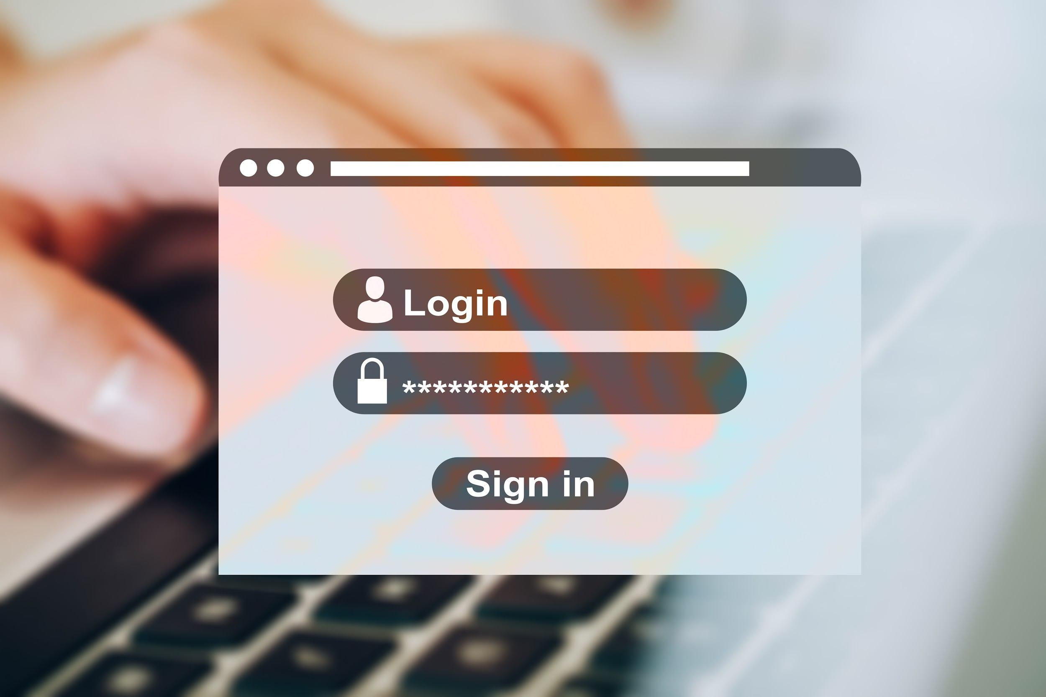
Security Challenge #1
Their log-in process is totally insecure.
Notes:
Today, hackers are routinely logging in as users (and administrators) and gaining access to company data and financial assets.
Today, hackers are routinely logging in as users (and administrators) and gaining access to company data and financial assets.

Slide 43
Your Turn! Attacking the Wall
Instructions:
With your group, develop a list of 15 different ways that a malicious actor could penetrate the system and login as a user or administrator.
With each method, be prepared to describe the following:
Who (or what) is the initial target?
How would the actor implement the attack?
Be Prepared to Share!

Slide 44


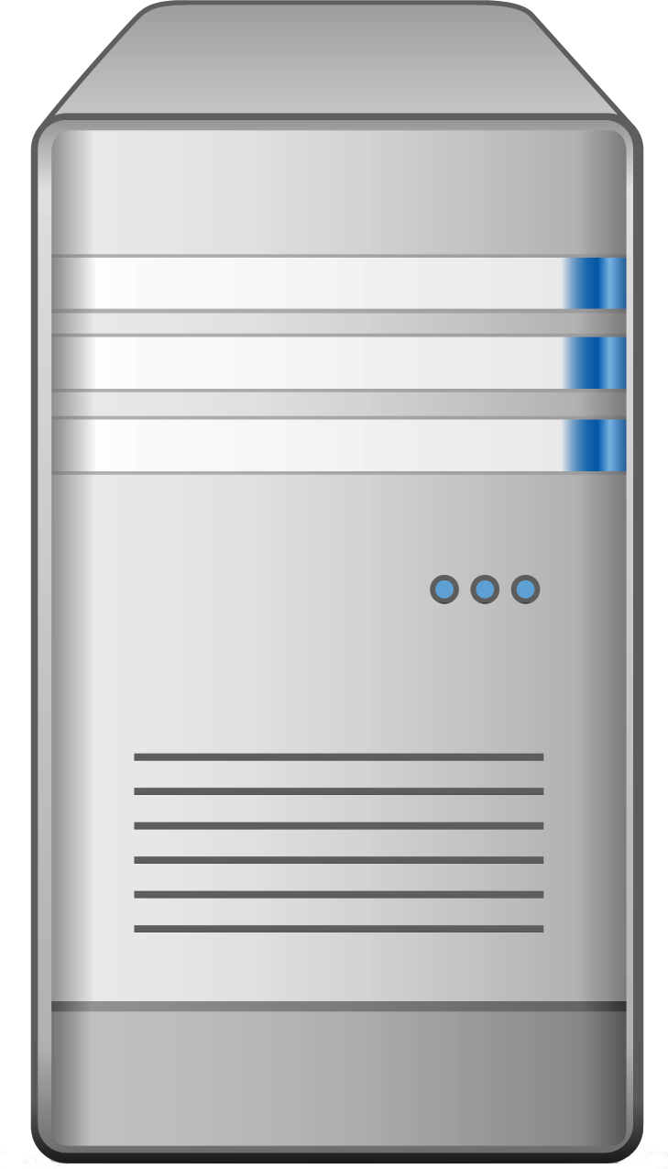

Your Turn! Attacking the Wall
Web Logins 101
Login
Web Login
Server
Data
We’ll spend a lot more time talking about web logins later in this course, but for now we’ll use this diagram as a guide.
Users and Admins

Slide 45
Your Turn! Attacking the Wall
Web Logins 101
Login
Web Login
Server
Data
Defend this with your life!
Users and Admins

Slide 46
Step #1:
Assess the Target

Slide 47
Your Turn! Attacking the Wall
A Lot of Targets
Login
Web Login
Server
Data
In this case, an attacker can target
every node along the chain.
Users and Admins

Slide 48
Your Turn! Attacking the Wall
User Attacks
Login
Web Login
Server
Data
Users are subject to a variety of social engineering tactics
Users and Admins

Slide 49
Your Turn! Attacking the Wall
Web Attacks
Login
Web Login
Server
Data
Websites are vulnerable to broad set of code related attacks.
Users and Admins

Slide 50
Your Turn! Attacking the Wall
Server Attacks
Login
Web Login
Server
Data
Servers are vulnerable to a host of operating system exploits and attacks.
Users and Admins

Slide 51
Your Turn! Attacking the Wall
Data Center Attacks
Login
Web Login
Server
Data
Data Centers are vulnerable to physical and cloud attacks.
Users and Admins

Slide 52
Step #2:
Define Attack Strategy

Slide 53
Step 2: Defining Attack Strategies
Fake Admin
Attack Option #1: Social Engineering
A hacker can ask users for their credentials by falsely pretending to be an administrator.

Slide 54
Step 2: Defining Attack Strategies
Fake Login
Login
Login
Attack Option #2: Phishing
A hacker can attempt a phishing attack where users are redirected to fake login pages to capture user credentials.

Slide 55
Step 2: Defining Attack Strategies
Login
Fake Login
Login
Login
Attack Option #3: Credential Reuse
A hacker can find users’ login and password information from other websites.

Slide 56
Step 2: Defining Attack Strategies
Login
Malware
Attack Option #4: Malware
A hacker could deploy malware such as spyware or keyloggers to capture daily user activity.

Slide 57

Step 2: Defining Attack Strategies
Shady Wi-fi
Login
Attack Option #5: Man in the Middle Attack
A hacker can create a man in the middle attack by providing a free Wi-Fi hotspot to capture user credentials.

Slide 58
Step 2: Defining Attack Strategies
Packet Sniff
Login
Attack Option #6: Sniff Packet
A hacker can sniff packet traffic across insecure wireless networks such as a cafe or restaurant.

Slide 59
Step 2: Defining Attack Strategies
Login
Stolen Laptop
Attack Option #7: Stolen Hardware
A hacker can simply steal a computer and use the saved credentials to login.

Slide 60
Next up,
website attacks.

Slide 61
Step 2: Defining Attack Strategies
Username: bob@bbb.com Password: Love
Username: bob@bbb.com Password: Love123
Username: bob@bbb.com Password: Love123!
Username: bob@bbb.com Password: L@ve123
Login
Password Dictionary
Attack Option #8: Brute Force Attack
A hacker could simply utilize a Brute-Force Attack to attempt a continual battery of username and password combinations.

Slide 62
Step 2: Defining Attack Strategies
Username:
uName = getRequestString("username");
uPass = getRequestString("userpassword");
sql = 'SELECT * FROM Users WHERE Name ="' + uName + '" AND Pass ="' + uPass + '"'
Login
Password Dictionary
Attack Option #9: Code-Injection
A hacker could utilize a code-injection attack in which malicious code is directly injected into the username or password fields.

Slide 63
Step 2: Defining Attack Strategies
{}
SessionID Swap
Login
{}
Attack Option #10: Faulty Session Management
A hacker could exploit fault session management when developers incorrectly implement code for maintaining login and logouts.

Slide 64
Next up,
server attacks.

Slide 65
Step 2: Defining Attack Strategies
Vulnerable OS
Attack Option #11: OS Exploits
Serves, which run on operating systems like Windows and Linux, are subject to OS exploits when incorrectly patched.

Slide 66
Step 2: Defining Attack Strategies
Vulnerable OS
Attack Option #11: Malicious Software
Malicious software can be directly loaded onto the server by USB or other means.

Slide 67
Finally,
database attacks.

Slide 68
Step 2: Defining Attack Strategies
Username: postgres
Password= “”
Default Credentials
Attack Option #13: Default Credentials
Database management systems often come with default credentials that may not be changed.

Slide 69
Step 2: Defining Attack Strategies
Unpatched BDMs
Attack Option #14: Unpatched Database
Database management systems may be unpatched against publicly known vulnerabilities.

Slide 70
Step 2: Defining Attack Strategies
Lack of Segregation
Attack Option #15: Lack of Segregation
The Database may be set up to let a client peek at another client’s data.

Slide 71
Security Challenge #2

Slide 72
Activity: Security Challenge #2:
Defending the Wall
Now that we’ve assembled a list of potential attacks, your next task is to develop a list of at least 10 strategies to mitigate the website’s risk of unauthorized access.
Be Prepared to Share!
15 Minutes

Slide 73
Your Turn: Defending the Wall
User Attacks
Web Attacks
Database Attacks
Social Engineering
Brute-Force Attacks
Default Credentials
Phishing Attacks
Code Injection
Unpatched Database
Credential Reuse
Faulty Sessions
Lack of Segregation
Malware Attacks
Server Attacks
Man in the Middle
To help you get started, review this list of identified attack types.
OS Exploit
Packet Sniffing
Malicious Software
Computer Theft

Slide 74
Step Three:
Risk Mitigation Plan

Slide 75
Step 3: Risk Mitigation Plan
User Attacks
Web Attacks
Database Attacks
Social Engineering
Brute-Force Attacks
Default Credentials
Phishing Attacks
Code Injection
Unpatched Database
Credential Reuse
Faulty Sessions
Lack of Segregation
Malware Attacks
Server Attacks
Man in the Middle
Risk Mitigation begins by assessing all risks and looking for parallels.
OS Exploit
Packet Sniffing
Malicious Software
Computer Theft

Slide 76
Step 3: Risk Mitigation Plan
User Attacks
Social Engineering
User Risk Mitigation
Educate all users on the danger of phishing and social engineering.
User randomly generated passwords.
Ensure users are using multifactor authentication (password + phone confirmation)
Use HTTPS and only access sensitive content over secure channels.
Phishing Attacks
Credential Reuse
Malware Attacks
Man in the Middle
Packet Sniffing
Computer Theft

Slide 77
Step 3: Risk Mitigation Plan
Web Attacks
Web and Server Risk Mitigation
Ensure strong passwords are used (i.e., alphanumeric +symbol + special characters).
Sanitize any input in the web application form fields and filter out.
Ensure users are immediately logged out when closing a browser. (No preservation of login after 30 seconds of inactivity.)
Ensure that all servers are routinely patched against latest know vulnerabilities.
Antivirus and User Education.
Brute-Force Attacks
Code Injection
Faulty Sessions
Server Attacks
OS Exploit
Malicious Software

Slide 78
Step 3: Risk Mitigation Plan
Suggested Plan
Educate all users on the dangers of phishing and social engineering.
Require randomly generated passwords passwords.
Ensure users are using multifactor authentication (password + phone confirmation).
Use HTTPS and only access sensitive content over secure channels.
Ensure strong passwords are used (alphanumeric + symbols).
Sanitize any input in the web application form fields and filter the output.
Ensure users are immediately logged off when closing a browser. (No preservation of login after 30 seconds of inactivity).
Ensure all servers are routinely patched against latest known vulnerabilities.
Ensure physical access to servers is protected by multiple forms of authentication (login + biometric).
Ensure that all data stored in the database is encrypted and cannot be read without additional login information.
Provide database access on need-to-know basis.
Log and monitor all database access.
Ensure that all cloud security platforms follow best practices for security implementation.
Notes:
As security professionals, we will make our recommendations based on observed risks. In conjunction with our clients, we will also make decisions on the best course of action.

Slide 79
Cybersecurity Framework

Slide 80
Our Cybersecurity Framework
Even in our simple exercise, we begin to see an emerging framework for addressing cybersecurity threats.
Identify
Targets
Determine Attacks
Mitigate Risks

Slide 81
NIST Cybersecurity Framework
As we progress through class, we’ll begin to understand larger frameworks for addressing cybersecurity threats.
NIST CYBERSECURITY FRAMEWORK (CSF)
Identify
Protect
Detect
Respond
Recover

Slide 82
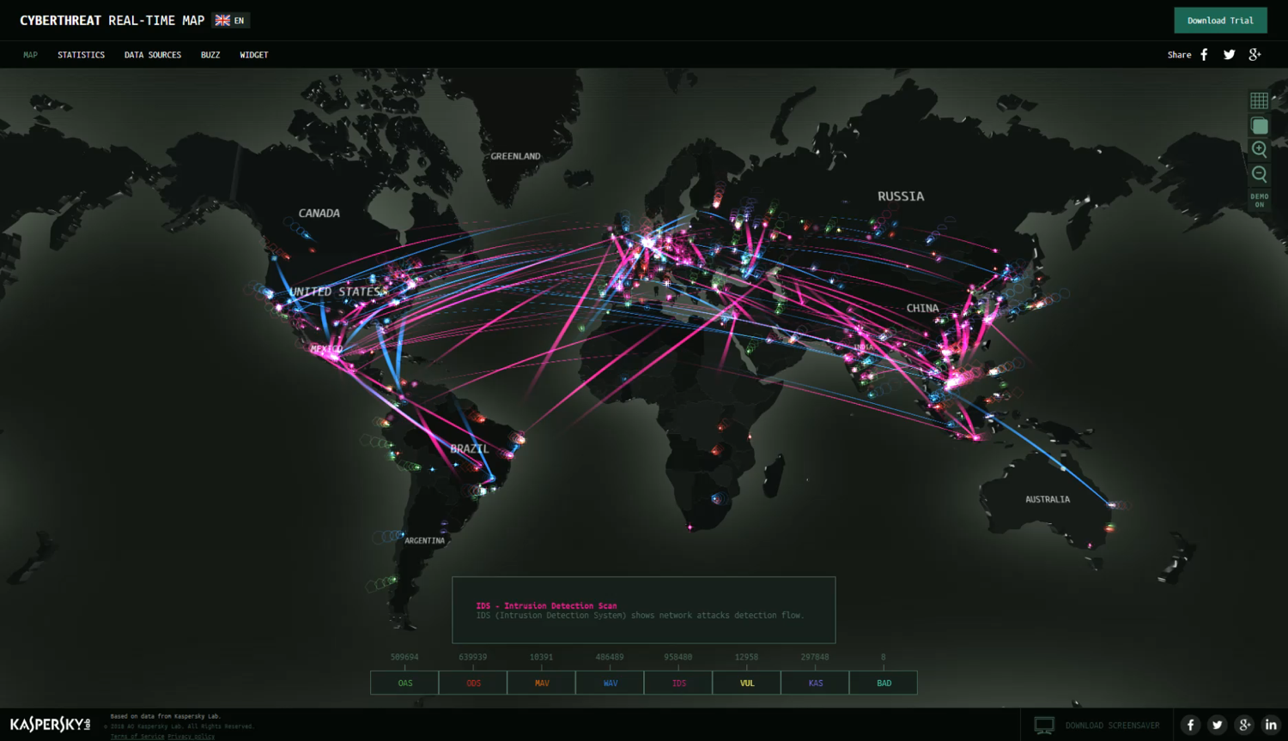
Next Class...
We’ll dive deeper into today’s threat landscape and discuss modern day tasks we’ll be tasked with handling.
Notes:
Screengrab: from https://cybermap.kaspersky.com/

Slide 83
Any Questions?

